Slide 1
Mitigating GHG Emissions
An EPA Perspective
Georgia Institute of Technology
March 4, 2015
Ken Mitchell, Ph.D.
U.S. Environmental Protection Agency
Atlanta, GA

Slide 2


Outline
The Clean Air Act:
A 40K foot view
Some Key EPA Actions on Climate Change Mitigation
  Mobile Sources
  EPA’s Clean Power Plan
  Oil and Gas
  Voluntary Programs
www.epa.gov/climatechange and www.epa.gov/cleanpowerplan

Slide 3
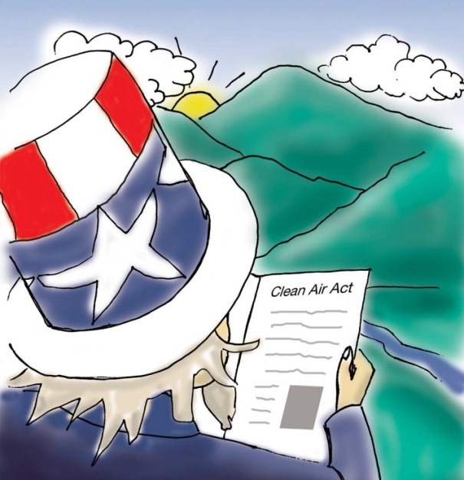
The Clean Air Act – A 40K Foot View
The 1990 Clean Air Act (CAA) Amendments are the most recent version of a law first passed in 1970 to clean up air pollution
Some CAA Accomplishments since 1970
  Six common air pollutants have decreased by more than 50%
  Toxic air pollution from large industrial sources, such as chemical
  plants, petroleum refineries, and paper mills have
  been reduced by nearly 70%
  New cars are more than 90% cleaner and
  will be even cleaner in the future, and
  Most ozone-depleting chemical production
  has ceased
At the same time…
  U.S. gross domestic product has tripled
  Energy consumption has increased by 50 percent, and
  Vehicle use has increased by almost 200 percent

Slide 4
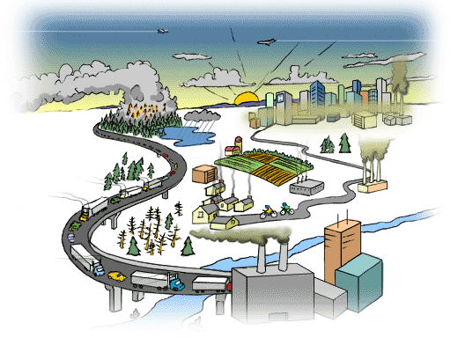
Some Key Efforts Under the CAA
Cleaning Up Outdoor Air
  NAAQS pollutants (e.g.,
  Ozone, PM), Regional Haze,
  air toxics, acid rain
Cleaner vehicles,
engines, and the fuels
that power them
Addressing Climate change
Protecting the stratospheric
ozone layer
Indoor air is also a focus of OAR
efforts, but not explicitly addressed
in the CAA
Courtesy of Sustaining the Environment and Resources for Canadians

Slide 5
CAA Chemicals of Focus
CAA
Six Common Pollutants
(Criteria or NAAQS Pollutants)
O₃, PM, CO, SO₂, NO₂, Pb
Hazardous Air Pollutants from Industry
188 Chemicals and Compounds
Greenhouse Gases
CO₂, CH₄, N₂O, Fluorinated Gases
Emissions from Cars, Trucks, and Nonroad Equipment
Diesel Exhaust, Toxic Pollutants, Greenhouse Gases
Stratospheric O₃ Depleting Chemicals
Indoor Air Pollutants*
Our Focus for Today
*Indoor air pollutants are not formally regulated under the CAA

Slide 6
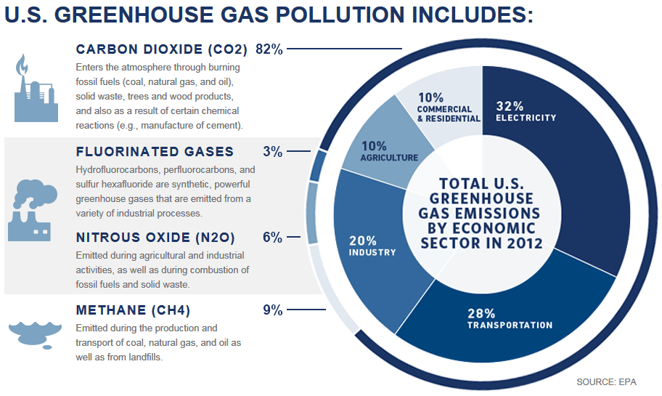
U.S. GHG Pollution

Slide 7
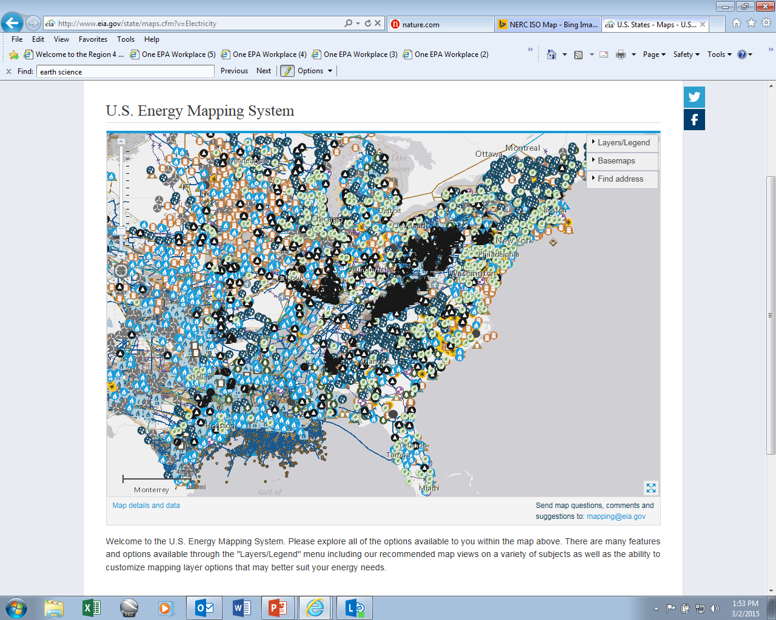
The U.S. Energy System – It’s Complicated!
Early Outreach Informed This Proposal

Slide 8






EPA Actions to Reduce Carbon Pollution
Building a 21st century transportation sector
Cutting energy waste in homes, businesses, and factories
Reducing methane and HFCs
Preparing the U.S. for the impacts of climate change
Helping lead international efforts to address global climate change
Reducing carbon pollution from power plants (e.g., EPA’s “Clean Power Plan”)

Slide 9
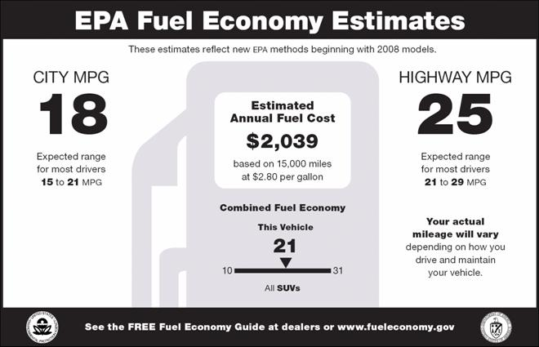
Mobile Sources
Increasing fuel efficiency, reducing GHG emissions….
EPA and the National Highway Traffic Safety Administration (NHTSA) are taking coordinated steps to enable the production of a new generation of clean vehicles, through reduced greenhouse gas (GHG) emissions and improved fuel use from on-road vehicles and engines, from the smallest cars to the largest trucks; for example….
  Final rule (issued 8/28/2012) – Extends passenger vehicle program to model year 2017 through 2025 (average 163 grams CO₂ per mile, 54.5 mpg in model year 2025)
Energy Independence and Security Act
requires a significant increase in
renewable fuels to displace petroleum
consumption
  36 billion gallons by 2022
  Requires GHG lifecycle analysis
http://www.epa.gov/otaq

Slide 10
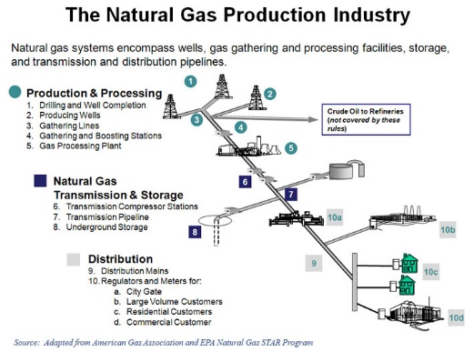
Addressing Methane
January 14, 2015 -- As part of the Obama Administration’s commitment to addressing climate change, EPA outlined a series of steps it plans to take to address methane and smog-forming VOC emissions from the oil and gas industry, in order to ensure continued, safe and responsible growth in U.S. oil and natural gas production
The agency’s commonsense strategy
will:
  Reduce methane pollution from new
  sources in this rapidly growing industry
  Reduce ozone-forming pollutants from
  existing sources in areas that do not
  meet federal ozone health standards
  Build on work that states and industry
  are doing to address emissions from
  existing sources elsewhere
http://www.epa.gov/airquality/oilandgas/

Slide 11
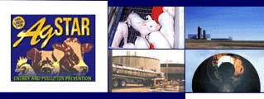









Mitigation – Multiple Voluntary/Partnership Programs

Slide 12
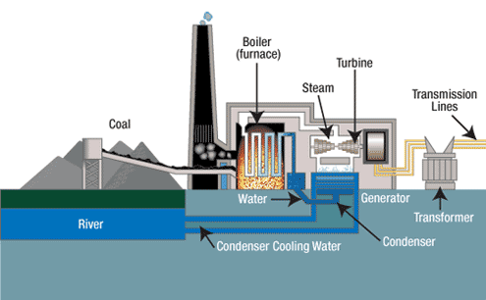
GHG NSPS Requirements for Fossil Fuel-Fired Power Plants
        Our climate is changing, and we’re feeling the dangerous and costly effects right now
          Average temperatures have risen in most states since 1901, with seven of the top 10 warmest years on record occurring since 1998
          Climate and weather disasters in 2012 cost the American economy more than $100 billion
        Although there are limits at
        power plants for other
        pollutants like arsenic and
        mercury, there are currently
        no national limits on carbon
          Children, the elderly, and the
          poor are most vulnerable to a
          range of climate-related health
          effects, including those related
          to heat stress, air pollution,
          extreme weather events, and others
http://www.epa.gov/cleanpowerplan

Slide 13
GHG NSPS Requirements for Fossil Fuel-Fired Power Plants
        EPA is working to develop carbon pollution standards, regulations or guidelines, as appropriate, for:
        New power plants
          Proposed January 8, 2014
          Final Summer 2015
        Modified and reconstructed
        power plants
          Proposed June 2014
          Final Summer 2015
        Existing power plants
          Proposed Guidelines June 2014
          Final Guidelines Summer 2015
          State Plans due Summer 2016
          Proposed Federal Plan summer
          2015 (final ready summer 2016)
http://www.epa.gov/cleanpowerplan

Slide 14

Early Outreach Informed This Proposal
EPA conducted a robust pre-proposal stakeholder engagement process
  Participated in meetings with over 300 utility, consumer, labor
  and environmental groups since June 2013
  Held 11 public listening sessions around the country
    3,300 people attended
    More than 1,600 people offered oral statements
Reached out to all 50 states
  Some states noted their programs to address
  carbon evolved because of:
    The need to address carbon pollution
    Electric system that is dynamic, and in
    the midst of market changes
    Modernizing the power sector is good
    for the economy
Common themes included reliability, flexibility, affordability, time for plans and implementation

Slide 15
Summary - 111(d) Existing Power Plant Proposal
This Clean Power Plan (CPP) proposal will:
Reduce carbon pollution from existing power plants, for which there are currently no national limits
Maintain an affordable, reliable energy system and will help move us toward a cleaner, more stable environment for future generations
By 2030, reduce nationwide carbon dioxide emissions, from the power sector by approximately 30% from 2005 levels, with significant reductions to begin by 2020
Cut hundreds of thousands of tons of harmful particle pollution, sulfur dioxide and nitrogen oxides as a co-benefit
  Proposal will avoid an estimated 2,700 to 6,600 premature deaths and 140,000 to 150,000 asthma attacks in 2030
Provide important health protections to the most vulnerable, such as children and older Americans
Lead to health and climate benefits worth an estimated $55 billion to $93 billion in 2030
From soot and smog reductions alone, for every dollar invested through the Clean Power Plan - - American families will see up to $7 in health benefits

Slide 16
Summary - 111(d) Existing Power Plant Proposal
Build on actions states, cities and businesses across the country are already taking to address the risks of climate change
Spur investment in cleaner and more efficient technologies, creating jobs and driving innovation
Require a reasonable emission reduction glidepath starting in 2020
Provide a flexible timeline—up to 15 years from guideline issuance—for all emission reduction measures to be fully implemented in 2030
  Recognizing that investments in infrastructure can take time to put in place and
  Avoiding stranded assets
Provide an array of tools states can use to formulate approvable plans.
http://www.epa.gov/cleanpowerplan

Slide 17
Other Benefits
Electricity bills down
8% in 2030
8%

Slide 18
After Proposal, Coal & Natural Gas Remain Leading Sources of Electricity Generation
Each more than 30% of projected generation in 2030

Slide 19
Background: Clean Air Act Section 111(d)
Best System of Emission Reduction
Previous EPA rules under this section of the Clean Air Act
have considered “add-on” control technologies – like
scrubbers -- that are technically feasible to deploy at
virtually any facility
In contrast, there are a wide variety of ways to reduce
carbon pollution that are commercially available,
technically feasible, and cost effective
The opportunities vary from state to state, depending on how electricity is generated, energy infrastructure, and other factors
In this proposal, EPA took an approach that viewed the Clean Air Act factors in determining Best System of Emission Reduction (BSER) in light of the interconnected nature of power generation
    BSER factors
      Costs
      Size of reductions
      Technology
      Feasibility
http://www.epa.gov/cleanpowerplan

Slide 20
EPA Establishes a Goal for Every State
EPA analyzed the practical and affordable strategies that states and utilities are already using to lower carbon pollution from the power sector
Proposed goals are based on a consistent national formula, calculated with state and regional specific information
Each state goal is expressed as a rate (pounds of CO₂ per MWh) – a statewide number for the future carbon intensity of covered existing fossil-fuel-fired power plants in a state
The state rate goal is calculated to account for
the mix of power sources in each state and the
application of four “building blocks” that make
up the best system of emission reduction
States will need to meet an interim goal and
a final goal

Slide 21
Building Block | Strategy EPA Used to Calculate the State Goal | Maximum Flexibility: Examples of State Compliance Measures
Make fossil fuel-fired power plants more efficient | Efficiency Improvements | Efficiency improvements Co-firing or switching to natural gas Coal retirements Retrofit carbon capture and sequestration (CCS)
Use lower-emitting power sources more | Dispatch changes to existing natural gas combined cycle (CC) | Dispatch changes to existing natural gas CC
Build more zero/low-emitting energy sources | Renewable Energy Certain Nuclear | New NGCC Renewables Nuclear (new and up rate) New coal with CCS
Use electricity more efficiently | Demand-side energy efficiency programs | Demand-side energy efficiency programs Transmission efficiency improvements Energy storage

Slide 22
Flexibilities Available To States
  Timing
    Up to 15-year window in which to plan for and achieve reductions in carbon pollution
    Up to two or three years to submit final plans
Form of goal
  States can use either a rate-based or mass-based goal
Single or multi-state plans
  States can collaborate and develop plans on a multi-state basis
Selection of measures
  States will choose how to meet the goal through whatever
  collection of measures reflects its particular circumstances
  and policy objectives
  State measures may impact and, in fact may be explicitly
  designed to reduce, CO₂ emissions from utilities on a regional
  basis
  EPA would support building off existing reduction programs
http://www.epa.gov/cleanpowerplan

Slide 23
States Have Flexibility
As an example, states could do less in the early years, and more in the later years, as long as on average it meets the goal
Carbon emissions from affected power plants in an example state
Timing of Power Plant Emission Reductions

Slide 24
When States Plan, They Can…
  Look broadly across the power sector for strategies that get reductions
  Choose to rely to varying degrees on measures that EPA used to calculate the goal, or on other measures that were not part of the state goal-setting analysis
  Invest in existing energy efficiency programs or create new ones
  Consider market trends toward improved energy efficiency and a greater reliance on lower carbon energy
  Tap into investments already being made to upgrade aging infrastructure
  Expand renewable energy capacity
  Integrate their plans into existing power sector planning processes
  Design plans that use innovative, cost-effective regulatory strategies
  Develop a state-only plan or collaborate with each other to develop plans on a multi-state basis
  Decide how to treat plants nearing the end of their useful life and how to help plants avoid “stranded investments”

Slide 25
Proposed Implementation Timeline*
2015
2016
2017
2018
2019
2020
State submits Negative Declaration
by June 30, 2016
State submits negative declaration
EPA publishes FR notice
Emission Guideline Promulgation
June 1, 2015
Compliance period begins
2020
State submits complete implementation Plan by June 30, 2016
by June 30, 2016
State submits plan
EPA reviews plan and publishes final decision within 12 months on approval/disapproval
State submits initial Plan by June 30, 2016 and request 1-year extension
by June 30, 2016
State submits initial plan and request for 1-year extension
EPA reviews initial plan and determines if extension is warranted
by June 30, 2017
State submits complete plan
EPA reviews plan and publishes final decision within 12 months on approval/disapproval
State submits initial multi-state Plan by June 30, 2016 and request 2-year extension
By June 30, 2016
State submits initial multi-state plan and request for 2-year extension
EPA reviews initial plan and determines if extension is warranted
by June 30, 2017
State submits progress report of plan
by June 30, 2018
States submits multi-state plan
EPA reviews plan and publishes final decision within 12 months on approval/disapproval
*See Update: http://www2.epa.gov/carbon-pollution-standards/fact-sheet-clean-power-plan-carbon-pollution-standards-key-dates

Slide 26
Actions since the proposal
October 28, 2014 - EPA issued a supplemental proposal to its proposed CPP that sets area-specific goals for Indian country and territories
October 28, 2014 - EPA issued a Notice of Data Availability (NODA)
related to the proposed CPP
November 6, 2014 – EPA issued a Technical Support Document (TSD) on converting rate-to-mass
November 19, 2014 – EPA issued second draft
of Framework for Assessing Biogenic Carbon Dioxide
for Stationary Sources and associated memo from Janet McCabe

Slide 27
During the comment period….
The proposed rule and supporting technical information, are available online at: http://www.epa.gov/cleanpowerplan
EPA held 4 public hearings the week of July 28th in Denver, Atlanta, Pittsburgh and Washington, D.C. – over 2,700 people attended
Comments on the CPP proposed rule and NODA closed
December 1, 2014; almost 4 million comments received
Comments on the proposal are identified by Docket ID Number:
EPA-HQ-OAR-2013-0602

Slide 28

Questions? mitchell.ken@epa.gov

